Slide 1
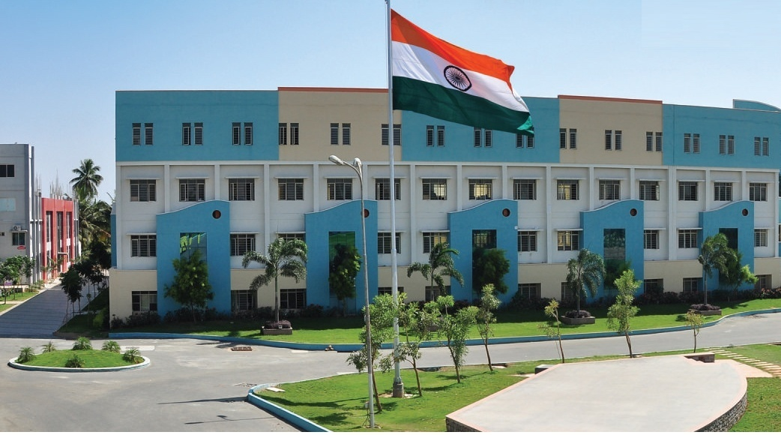
SRI ESHWAR COLLEGE OF ENGINEERING
ACADEMIC YEAR : 2017-18
DEPARTMENT : CIVIL
SECTION : 4 -YEAR
FINAL YEAR PROJECT FIRST REVIEW
DATE OF REVIEW: 07.07.2017

Slide 2
PLANNING, ANALYSIS, DESIGN OF SCHOOL BUILDING
By
ANJANA JOSEPH
DINESH KUMAR.B
VIJAYALAKSHMI.S
ARUN KUMAR.R
GUIDED BY,
Mr. SIDDHARTH.K
ASST.PROFESSOR
CIVIL DEPARTMENT

Slide 3
CONTENTS
Introduction
Abstract
Objectives
Methodology
Literature review
Work plan
Line plan
Analysis

Slide 4
INTRODUCTION
Education is the process of gaining information about the surrounding world while knowledge is something very different
The world becomes empty without education.
Therefore it is necessary to construct a platform which helps to gain all these information and knowledge

Slide 5
ABSTRACT
STATEMENT OF THE PROJECT
Salient features:
Building type : School building
Total area : 5,19,125sqft
No of storey : G+2
Area of building : 99,054sqft
Type of
Construction : RCC structure
Type of walls : Brick wall
Material : M30 g-concrete & Fe415 g-steel

Slide 6
OBJECTIVES
To plot the line plan using AUTOCAD.
To analyze the plan using STAAD PRO.
To manually design beams, columns and slab.

Slide 7
METHODOLOGY
Topic selection
Basic planning of project
Data collection
Literature study
Planning using Auto CAD
Designing and analysis using STAAD PRO
Project conclusion

Slide 8
LITERATURE REVIEW
S .No | TITLE | JOURNAL | AUTHOUR | DESCRIPTION
1 | Planning ,analysis and design of school building | International journal of civil Engineering | Rahul chandran, S.Varsha | The main aim of this paper is to give a peaceful environment and general facilities for community surrounding the school
2 | G+2 Building | International journal of Civil Engineering (Issue .6,Vol. 5) <2014> | Prakriti joshi, Prashika Tamang | In this structural design of A building using green concept, So the structure remains strong throughout its lifetime

Slide 9
LITERATURE REVIEW (contd.,)
S .No | TITLE | JOURNAL | AUTHOUR | DESCRIPTION
3 | Improving the Classroom Physical Environment: Classroom Users’ Perception | International journal Modern Engineering research | Shamsidar Ahmad | The purpose of this paper is to investigate classroom users’ perception on their conventional classroom and how they perceive on the preferred classroom physical environment.
4 | Effects of school design on student outcomes | Journal of Educational Administration Journal of Educational Administration | C. Kenneth Tanner | –The purpose of this study is to compare student achievement with three school design classifications: movement and circulation, day lighting, and views.

Slide 10
LITERATURE REVIEW (contd.,)
S .No | TITLE | JOURNAL | AUTHOR | DESCRIPTION
5 | Designing and Planning Laboratories | International journal on Educational Planning | Rahul J .Kolekar | The main aim of this paper is to help those planning and designing laboratories in schools, whether it’s a whole new science suite or a refurbishment of an individual lab
6 | A Case for Schoolhouse Aesthetics | International journal on Educational Planning | Charles Kenneth Tanner | school systems consider the instructional needs of the students they serve, enrollment, and whether to replace or remodel an old building

Slide 11
WORKPLAN
S.NO | DATE | DESCRIPTION
1 | 07.7.17 | Selection of title
2 | 14.7.17 | Approval of title by guide
3 | 02.8.17 | Planning process to be done
4 | 12.8.17 | First step of analysis process to be started
5 | 29.8.17 | Structural Analysis
6 | 15.9.17 | Structural Design
7 | 22.9.17 | To submit the project book
8 | 05.10.17 | Final review

Slide 12
Thank you

